Slide 1
North Coast Transmission Line
Virtual Open House
June 23 and 24, 2025

Slide 2

Virtual Open House Etiquette
Cameras are turned off to save bandwidth
Use the ‘raise your hand’ button for comments/ questions
  One question and a follow-up
  Additional questions after all have had a turn
Share air space so that everyone can participate
Challenge ideas, not people
We’re not recording this session, and kindly ask that others don’t record

Slide 3
Agenda
Introductions
North Coast Transmission System Expansion
Collaboration and Partnership with First Nations
North Coast Transmission Line Overview
Routing
Studies and 2025 Activities
Worker Accommodation, Laydown and Heli Infrastructure
Fire Safety
Procurement and Employment
Schedule
Other North Coast projects

Slide 4
Welcome
We’re bringing more clean, reliable electricity to the North Coast to:
  foster economic growth and support export capacity from the port
  help our customers power their operations
  help reduce greenhouse gases
We’re proposing to:
  upgrade existing and build new infrastructure from Prince George to Terrace
  build new infrastructure north of Terrace and in the Prince Rupert area
Based on demand level and location, we may also need new infrastructure from:
  Terrace to Kitimat
  Terrace to Prince Rupert

Slide 5
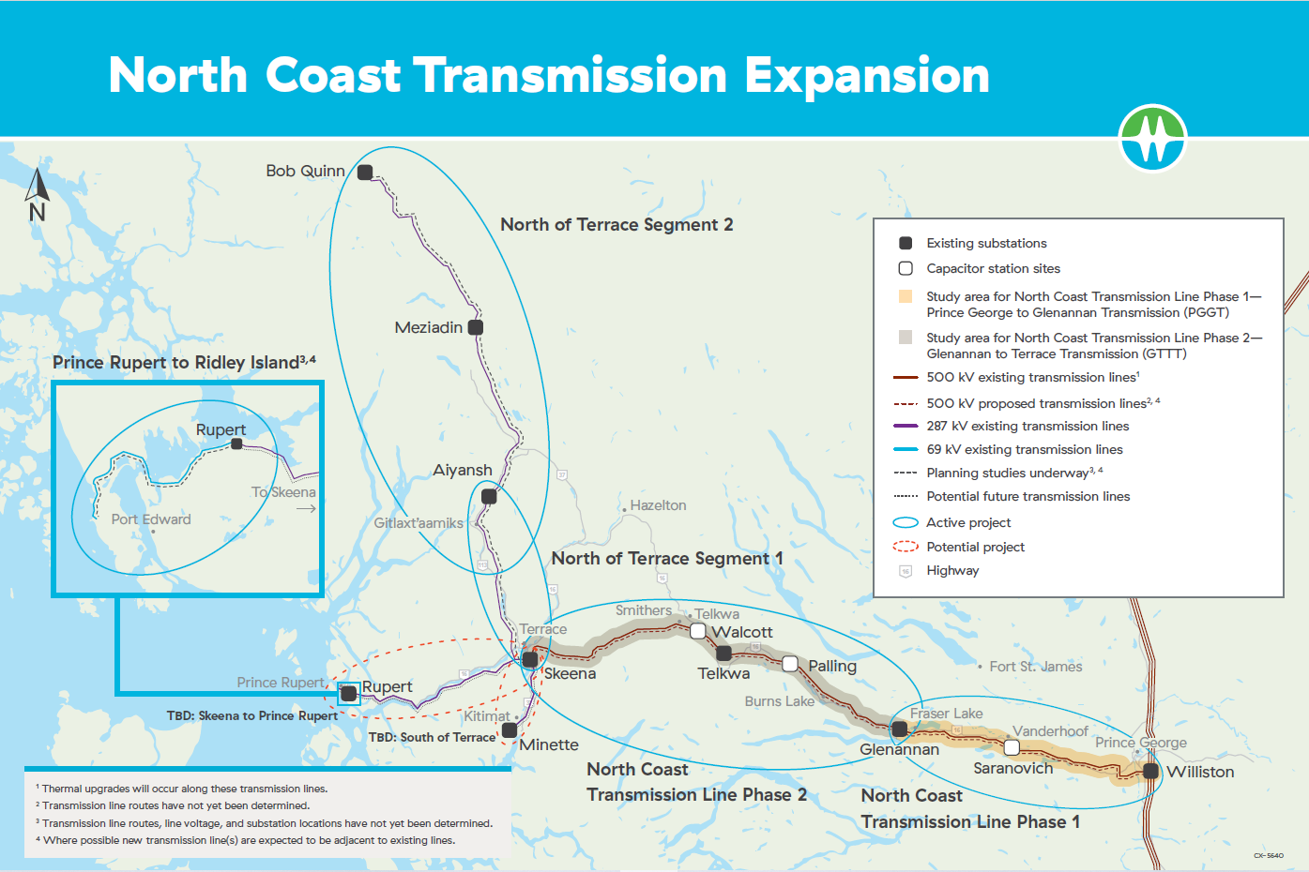

Slide 6
Collaboration and Partnership with First Nations
BC Hydro, the Province of BC and First Nations are collaborating on the planning and development of the proposed North Coast Transmission Line.
This aligns with BC Hydro’s commitment to:
  shared decision-making
  collaborative project assessment
  streamlined approaches to permitting
  Indigenous co-ownership of the North Coast Transmission Line
We’re thinking differently about how we do our business, and BC Hydro and First Nations are working together to advance reconciliation.

Slide 7
First Nations Collaboration & Partnership
Phase 1:
Stellat’en Nadleh Whut’en | Lheidli T’enneh Nazko | Saik’uz
Phase 2:
 | Wet’suwet’en Nation
Kitselas Kitsumkalum Lax Kw’alaams Metlakatla Stellat’en Nadleh Whut’en | Witset Wet’suwet’en First Nation Ts’il Kaz Koh Nee Tahi Buhn Skin Tyee | Houses of: Anaskaski Cas Yex DjakanYax G’inehklai Yex KaiYex Kwen Bea Yex Tsa K’ex Yex Tsai Yex

Slide 8
First Nations Collaboration & Partnership
Discussing co-ownership of the new transmission line:
  This is the first time BC Hydro and First Nations are seeking to enter co-ownership arrangements for transmission lines.
  Co-ownership offers First Nations the opportunity to receive long-term financial benefits from a new transmission line in their territory.
Collaborating on project planning and design, including route selection
  Some Nations are undertaking their own project assessment.
  Project conditions will incorporate environmental standards that reflect First Nations values to steward the land and support community well-being.
First Nations communities will participate in, and benefit from, project procurement, training and employment.

Slide 9
North Coast Transmission Line
Phase 1: Prince George to Glenannan Transmission
~ 170 km of new transmission lines between Williston and Glenannan substations
Phase 2: Glenannan to Terrace Transmission
~ 130 km of new transmission lines between Glenannan and Telkwa substations
~ 145 km of new transmission lines between Telkwa and Skeena substations
Both phases include
Substations:
  upgrade or expand Telkwa
  expand Williston, Glenannan, and Skeena
Capacitor station expansions – Saranovich, Palling, Walcott
Fibre optic cable on existing or new transmission structures

Slide 10
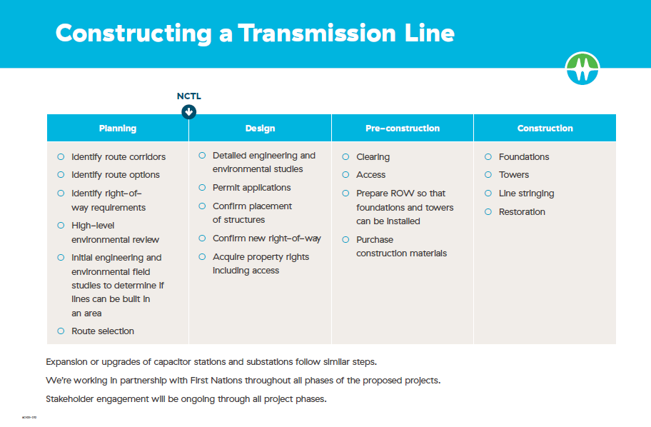

Slide 11
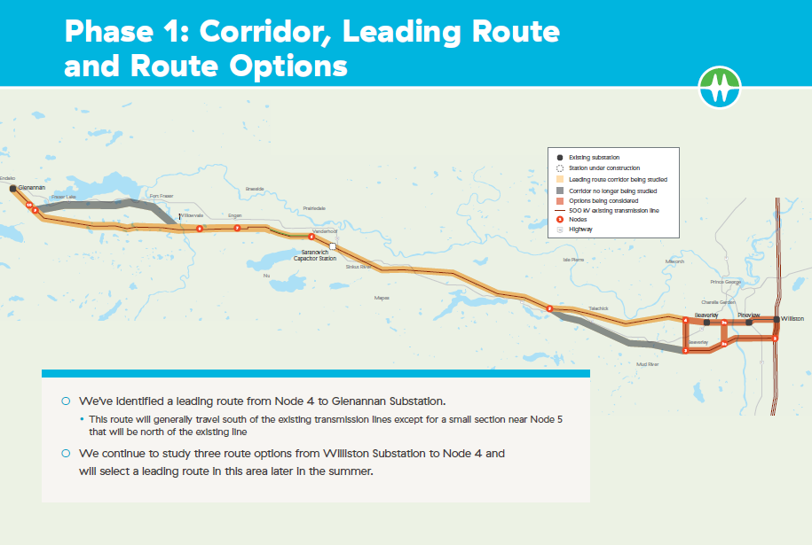

Slide 12
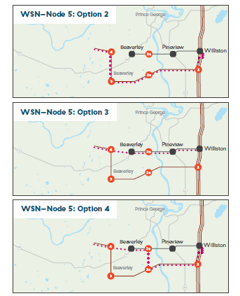
Phase 1 Route Options: Nodes 1 to 4
Option 1 has been removed from further study.
We continue to study Options 2, 3 and 4.
We’ll focus on refining our understanding of potential engineering challenges, impacts to endangered species, forestry and property.
We will identify a leading route in this area later in the summer

Slide 13
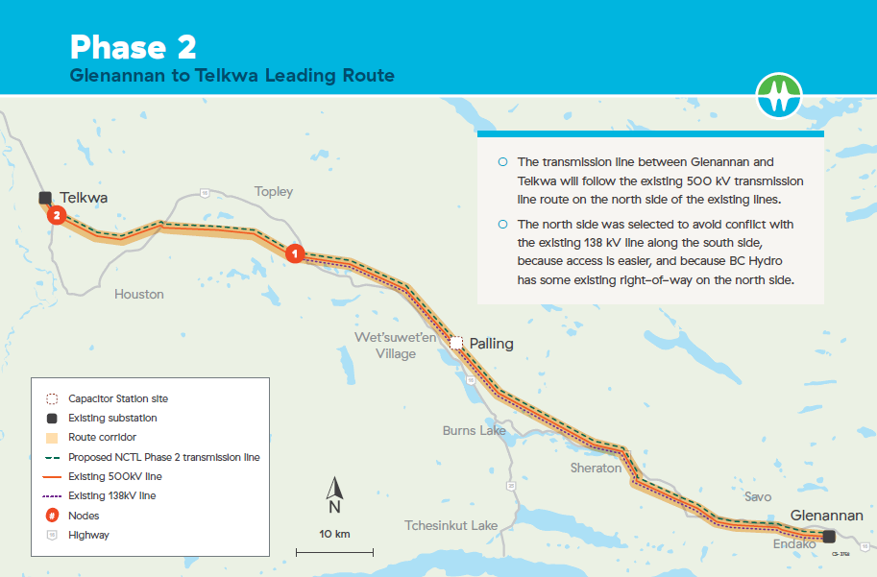

Slide 14
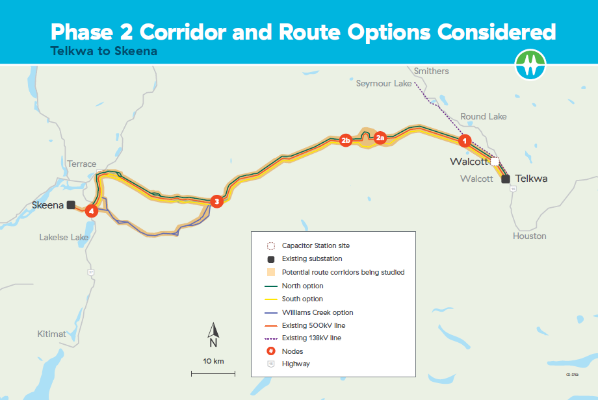

Slide 15
Phase 2: Routing Telkwa to Skeena
  Node 1 to 2b
  Discussions ongoing with First Nations regarding the leading route for this segment.
  Node 2b to Node 3
  Route goes through Telkwa Pass and will generally follow the existing route.
  Route is being studied further with a focus on terrain, proximity to existing pipelines, and access.
  Node 3 to 4
  The leading route will generally follow the existing route.
  Terrain, access and proximity to existing pipelines are main considerations.
  BC Hydro and First Nations worked together extensively to review route options for this area.
  Node 4 to Skeena
  The leading route will be on the north side of the existing transmission line.

Slide 16
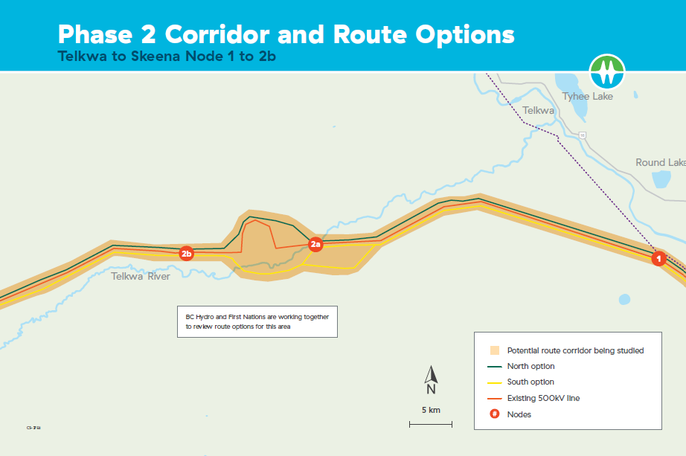

Slide 17
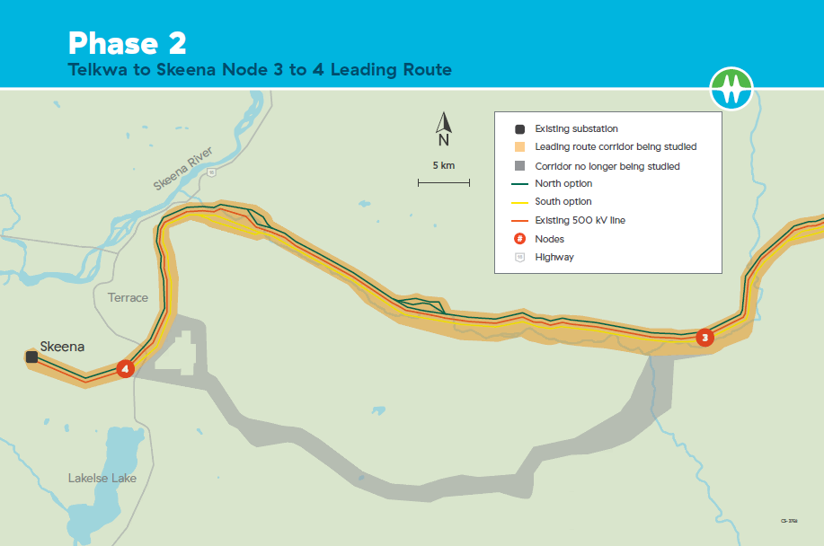

Slide 18
Phase 1: Environmental, Social & First Nations Led Studies
  Environmental studies started spring of 2024 and are continuing through 2025.
  Study areas vary by study and by where clearing and/or ground disturbance will occur.
  Schedule:
  Findings will inform environmental review and archaeological assessments to help develop:
    strategies to manage potential project effects
    mitigation and monitoring programs
    documents such as Construction Environmental Management Plan, permit applications
  Yinka Dene and First Nations Traditional Use and socio-economic studies are underway and will inform their assessment of project impacts on their interests.
Wildlife (amphibians, bats, birds, wildlife habitat, remote cameras) | May to August
Fish and Waterways (stream assessments) | Late May to June
Vegetation (Terrestrial Ecosystem Mapping, rare plants | June to August
Archaeology | May to September

Slide 19
Phase 1: Key Activities 2025
  Survey
    staking the centre line of the transmission line (i.e., the centre of the right-of-way)
    defining legal boundary of the right-of-way
  Environment Surveys and Investigations
    vegetation
    wildlife
    fish and waterways
    archaeology
  Forestry
    access and clearing layout along parts of the route

Slide 20
Phase 2: Environmental, Social & First Nations Led Studies
  BC Hydro and First Nations are working together to develop the approach to assessing potential environmental and social impacts and measures to address those impacts.
  Starting environmental studies in spring/summer 2025 and will complete them in 2026
    wildlife habitat
    fish: stream assessments
    vegetation: Terrestrial Ecosystem Mapping, rare plants
    archaeology
  Study areas vary by study and by where clearing and/or ground disturbance will occur.
  Findings will inform Environmental Review and Archaeological assessments to help develop strategies to deal with potential effects and monitoring programs.
  First Nations Traditional Use and socio-economic studies are underway or will be undertaken and will inform their assessment of project impacts on their interests.

Slide 21
Phase 2: Key Activities 2025
  Geotechnical Drilling - minor clearing and access work
  Helipad upgrades and replacements
  Access layout between Glenannan and Skeena substations
  Clearing layout between Glenannan and Telkwa substations
  Access maintenance upgrades
    Copper, Telkwa and North Copper Forestry Service Roads
    additional roads between Glenannan and Telkwa substations
  Environment
    archaeological investigations to support geotechnical drilling
    habitat studies and environmental monitoring
  Survey
    staking of the centre line of the transmission line (i.e., the centre of the right-of-way)
    defining the legal boundary of the right-of-way

Slide 22
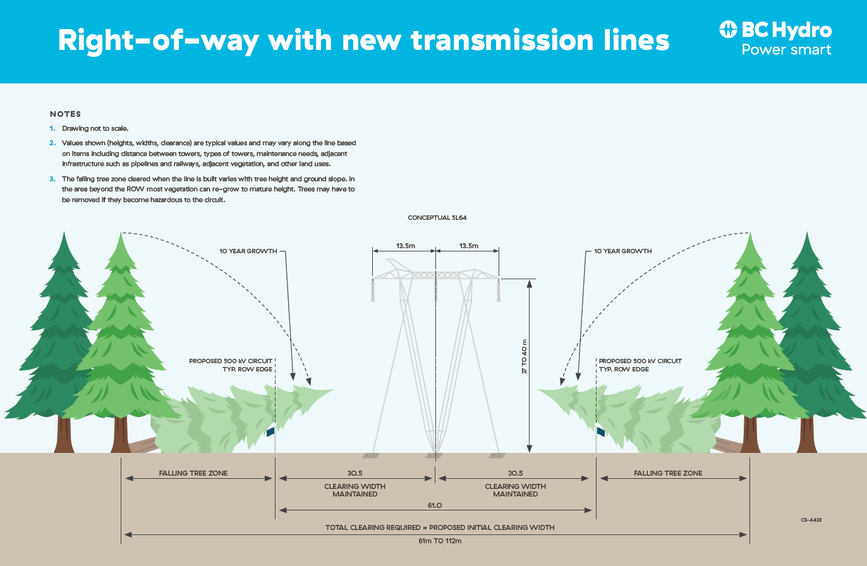

Slide 23
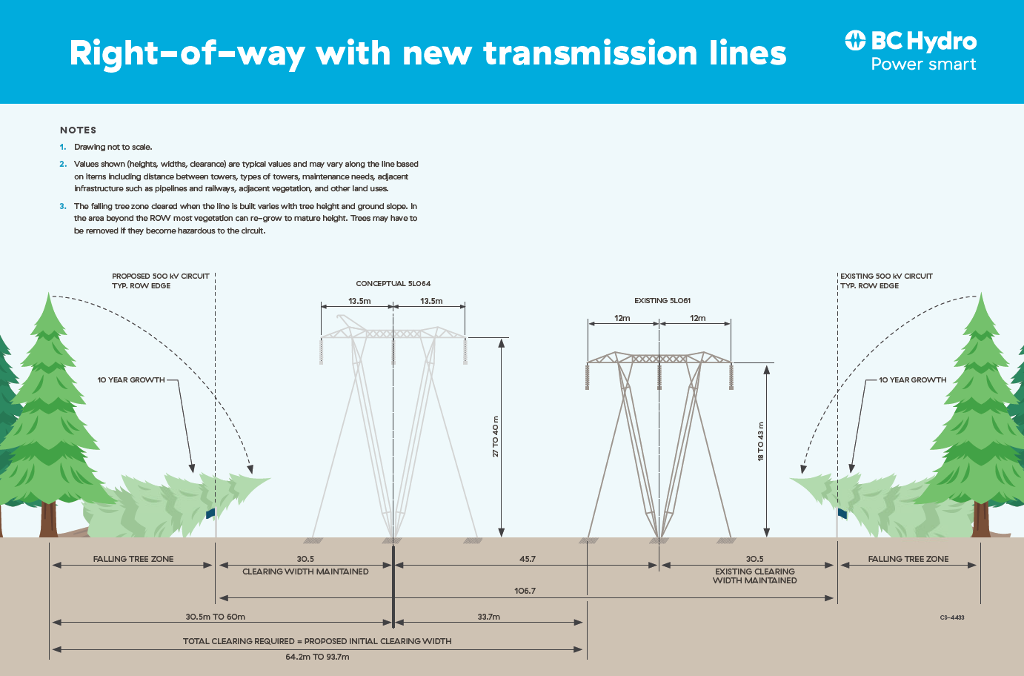

Slide 24
Worker Accommodation
  We’re working with First Nations and communities to develop a housing plan that meets project needs while considering First Nations and community concerns and interests.
  At peak construction, the workforce will be about 1500 to 1800 people.
  We anticipate hiring regional workers and contractors; however, we think we’ll need temporary camps in the following areas:
  We’ll also be considering locations for site offices and laydown areas.
General Location | Area | ~Capacity | ~Start | ~Duration
Vicinity of Fraser Lake | 10-15 ha | 400-500 | 2027 | 3-4 yrs
Vicinity of Telkwa Substation | 10-15 ha | 300-400 | 2027 | 3-4 yrs
Between Telkwa and Telkwa Pass | 5-10 ha | 200-300 | 2027 | 3-4 yrs
Between Terrace and Telkwa Pass | 5-10 ha | 200-300 | 2027 | 3-4 yrs

Slide 25
Worker Accommodation
  Camps will meet Provincial Industrial Camp requirements.
  In addition to accommodation,typical facilities include:
  Camp, site office or laydown area sites typically require grading, stripping, fencing, drainage and road development, and other improvements.
  We’re working with First Nations and communities to learn from their past experience with camps to identify ways to enhance positive effects and avoid or minimize negative impacts.
mobile generators or powerlines septic systems or fields potable water source kitchen | maintenance propane or other fuel recreation/culture communications first aid/health | waste management laundry parking lot fire and other safety security

Slide 26
Laydown and Helicopter Areas
  We’re working with First Nations and local communities to identify potential locations for laydown areas and areas to support helicopter use during project construction.
  We want to develop the facilities in a way that meets project needs while avoiding or minimizing potential impacts.
Laydown Areas
  Laydown yards are temporary spaces to receive and manage project materials, store construction equipment, and for site offices.
  Laydown areas require:
    All-weather road access to reduce impacts to deliveries due to road bans.
    Lighting, fencing, security and sanitary services.
    Generators and portable washrooms (connection to existing services is preferred).
  The areas must be able to support heavy truck deliveries and cranes year-round.
  We’ll also be considering locations for site offices and laydown areas.

Slide 27
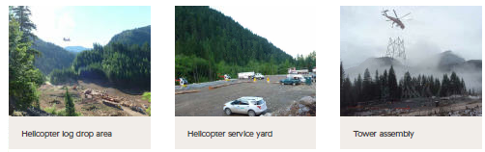
Laydown and Helicopter Areas
Helicopter Infrastructure
  We’ll need helipads, staging areas, drop sites, tower assembly sites and helicopter service yards between Telkwa and Skeena where we can’t access the line by road.
  We’re refining our needs and working with First Nations and communities to identify potential locations. Safety and efficiency are our key considerations.

Slide 28
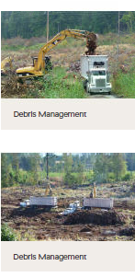
Fire Safety
  We take wildfire prevention and management seriously. We’ll work to both prevent wildfires and be ready to deal with them should they occur through:
  Wildfire Prevention and Management Plan
    Comply with the Wildfire Act, Regulation, and Open Burning Smoke Control Regulation
    Prevention strategies and best practices
    Preparedness and due diligence measures
    Response strategies and suppression tactics
  Wildfire Risk Assessment
    Values at risk
    Historical fire occurrences, weather, and climate
    Wildfire Threat Assessment
    Risk Management and Mitigation
    Response Resources
  Quick Deploy (portable) Weather Stations
    Localized site-specific weather monitoring
    Site specific fire weather indices and Fire Danger ratings
    Risk management and mitigation
    Accurate and appropriate regulatory compliance

Slide 29
Procurement
  We’re developing our procurement strategy in partnership with First Nations
    partnerships with First Nations will be a key consideration in the strategy
  Procurement will occur in three phases
    clearing and access
    lines
    stations
  Two types of opportunities:
    First Nations direct award where First Nations will identify designated businesses
    public bids
  All BC Hydro public procurement opportunities are published on BC Bid and we issue Notice to Vendors in BC Bid informing the public of upcoming procurement opportunities.
  We’ll also provide information about opportunities and the bidding process at public events and on our project website at www.bchydro.com/ncelectrification
  We’ve hired an engineering services provider, CIMA+, who will work with us to design the proposed Phase 1 transmission lines

Slide 30
Procurement
  Clearing and access – starts in early 2026
    One or more large scale forestry contractors with clearing, logging, grubbing experience, along with road construction and maintenance.
  Lines
    Line contractor(s) responsible for tower foundations, tower assembly and erection as well as line hardware installation and stringing.
  Stations
    Typically, an experience general electrical contractor will undertake both civil and electrical installation.
    Separate contracts for station expansion.

Slide 31
Employment
  We’ll start hiring for the project in early 2026.
  We’re developing a hiring strategy.
    We anticipate hiring transmission line construction contractors who will, in turn, hire workers for the job.
  We’ll provide information about the hiring process and/or Contractors to contact on our website, at public events and through other means.
  Construction on Phase 1 and Phase 2 is planned to start in summer and fall 2026, respectively.

Slide 32
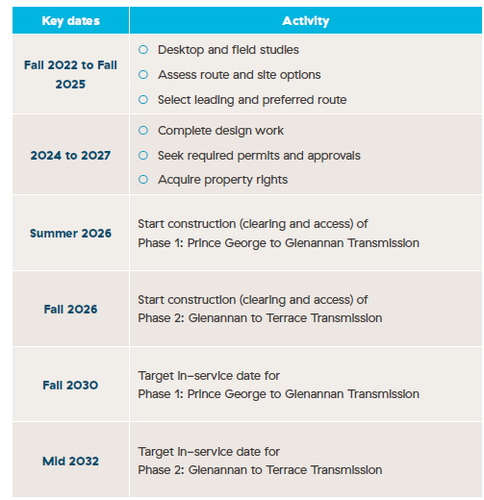
Proposed Schedule

Slide 33
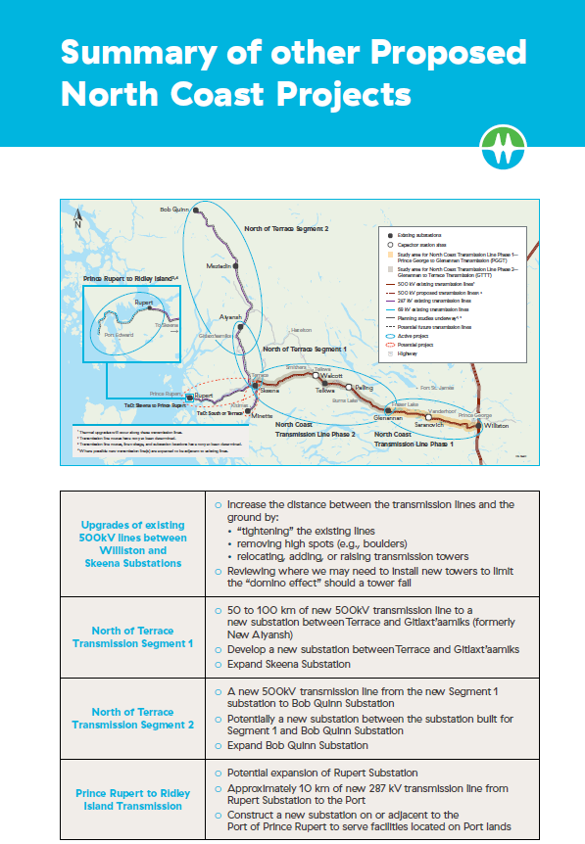

Slide 34
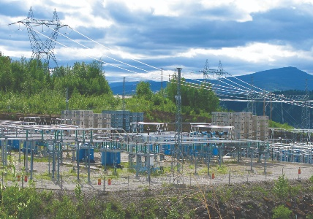
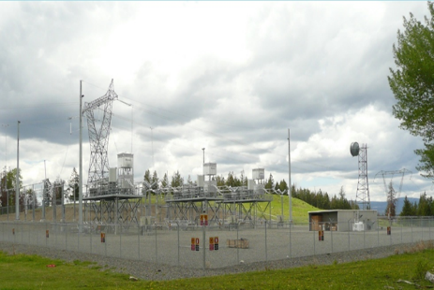
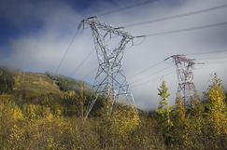
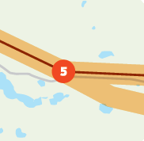
Thank you for attending
  We’ll continue to keep you informed as the proposed projects advance.
  For more information, please visit www.bchydro.com/ncelectrification.
  Please contact us at 1 866 647 3334 or at projects@bchydro.com if you have any additional questions or comments.

Slide 35
Secondary Research - Sources in Notes

