Slide 1
TERRACE TO KITIMAT TRANSMISSION PROJECT UPDATE
Feb/March 2015

Slide 2
Presentation overview
Terrace to Kitimat transmission project update
Recap
Why we need to replace the transmission line between Terrace and Kitimat
Options we studied and consulted on
Preferred option selected – and why
Next steps

Slide 3
SITUATION RECAP
Terrace to Kitimat transmission project update
Kitimat area supplied from Skeena Substation (SKA) by a single 287 kV transmission line (green) to Minette Substation (MIN)
MIN supplies Kitimat with distribution-level power
The line is reaching end of life; load growth in area best met with a new, higher capacity line
3

Slide 4
OptionS recap
Terrace to Kitimat transmission project update
BC Hydro studied/consulted on five options for replacing the existing transmission line
FOR CAPACITY (to provide more electricity, in order to meet load growth)
Two options: Single 287 kV line down west or down east side of Valley
FOR CAPACITY AND RELIABILITY (if one line out of service, the second still provides electricity)
Three options involving two new single circuit 287 kV transmission lines: one line on each side of valley; both on the east side; or both on west side
For all options, the short line from MIN to KIT would be replaced with a single new 287 kV transmission line

Slide 5
Preferred option: Single line, west side
Terrace to Kitimat transmission project update
DECISION BASED ON:
Technical feasibility
Constructability
Reliability
Preliminary environmental and archaeological study results
First Nations consultation
Stakeholder and public input
Cost
5

Slide 6
Why just one new line?
Terrace to Kitimat transmission project update
Higher capacity conductor on the new line will be able to carry more electricity than the conductor on the existing line
This means a single new line can meet BC Hydro’s forecasted load growth for the Kitimat area
This includes electricity requirements of potential industrial developments, such as LNG facilities
Discussions with developers indicate no desire for the additional redundancy that a second line would provide
If a second line is needed in the future, it could be built on the east or on the west side of the valley
The information we’ve accumulated would help in siting a second line
Further consultation would be done before a second line is installed
The next few slides will look at – Why west side of valley?

Slide 7
Feasibility, Constructability, cost
Terrace to Kitimat transmission project update
While building on either side of the valley is technically feasible, the west side provides some advantages:
Terrain on the west side is less challenging than on the east side, making a line on the west side somewhat more reliable. This also simplifies line design.
Routing on the west side is about 10 km shorter
The overall project cost for building the line on the west side is about 20% less than building on the east side

Slide 8
Environment, Archaeology
Terrace to Kitimat transmission project update
While desk-top studies showed east and west route areas similar for many criteria studied, the western provisional route crosses:
Less unstable or potentially unstable terrain
Fewer large, interconnected wetland and riparian areas
Less high-quality wildlife habitat for the 11 key species reviewed
Fewer recreational scenic viewpoints
These desktop study results will be further investigated through field studies in 2015

Slide 9
FEEDBACK RECEIVED
Terrace to Kitimat transmission project update
Feedback from local government representatives, First Nations and 2014 open house participants mostly favored a single line on the west side of valley because:
It will largely be out of sight
The viewscape along Highway 37 will improve, as the existing line will be removed once the new line is operating reliably
Initial studies show potentially less impact to fish, fish habitat and wildlife sites
It will not interfere with any future need to widen Highway 37
It will cost less
It’s a flexible solution, allowing a second line to be built, when needed

Slide 10
What would it look like?
Terrace to Kitimat transmission project update
Most structures will be steel H frames
Average height approx. 30 metres
Right of way width about 44 metres
One time additional danger tree clearing of approx. 26 metres on each side of right of way (allowed to grow back after construction)
10

Slide 11
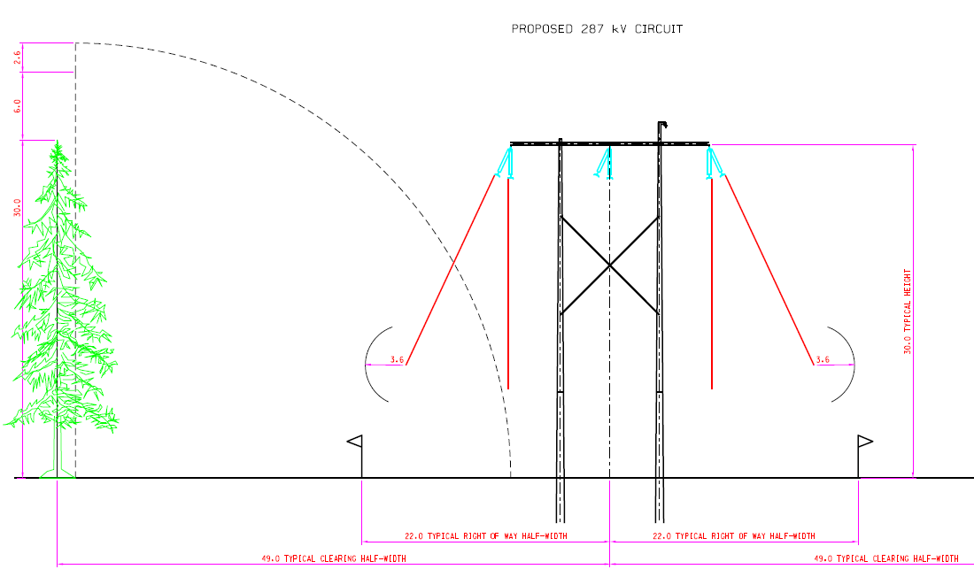
Terrace to Kitimat transmission project update

Slide 12
Next steps
Terrace to Kitimat transmission project update
Detailed environmental and archaeological field studies along the corridor
Geotechnical testing along the corridor
Detailed design work for the transmission line
Ongoing First Nations consultation
Stakeholder communications
Permitting and Crown Land tenure process
Procurement

Slide 13
Some key dates
Terrace to Kitimat transmission project update
Construction start: 2016/2017
Planned in-service date: 2018/2019

Slide 14
Questions?
Terrace to Kitimat transmission project update
For more information:
Lesley Wood
BC Hydro Stakeholder Engagement
604 623 4128; lesley.wood@bchydro.com
Or visit:
www.bchydro.com/tktp

